Slide 1


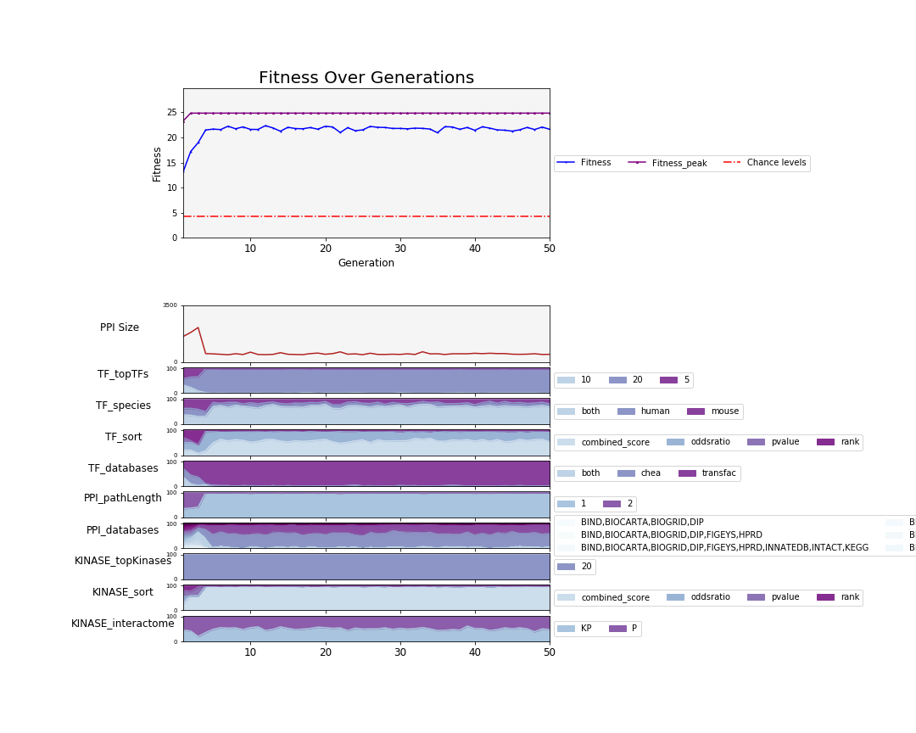
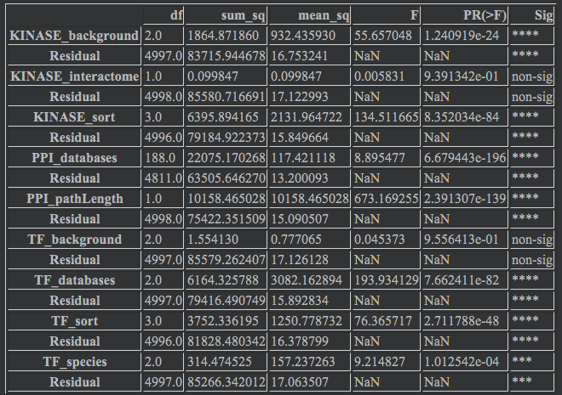
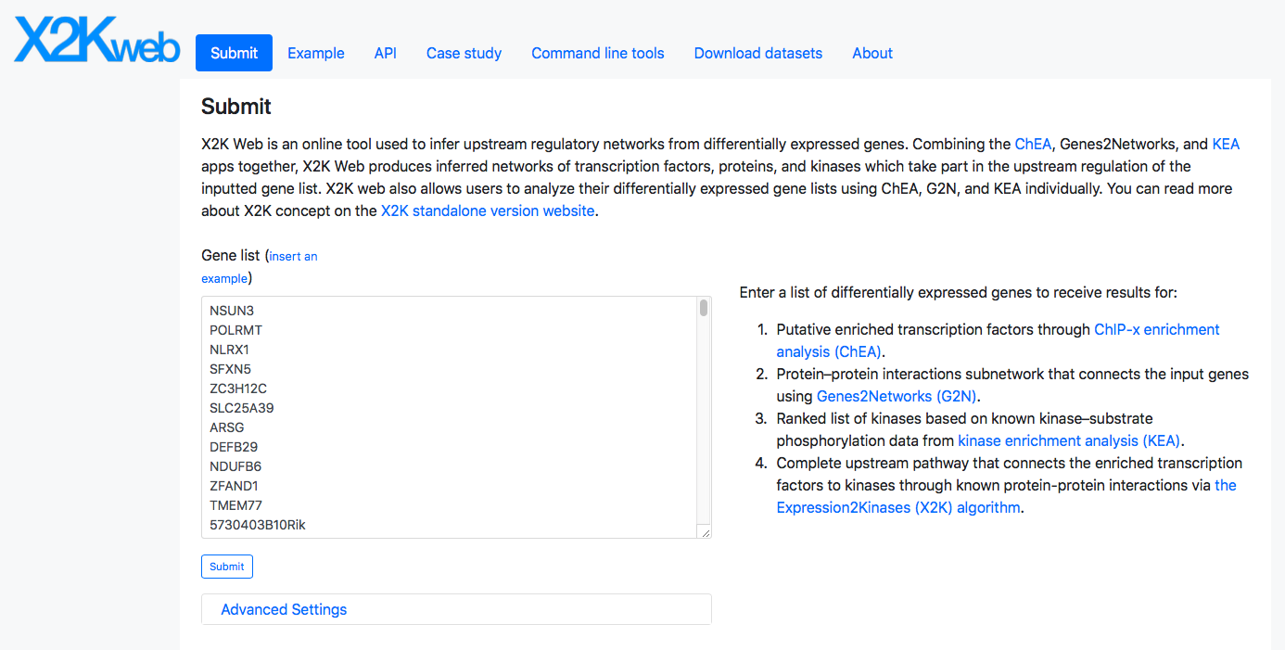
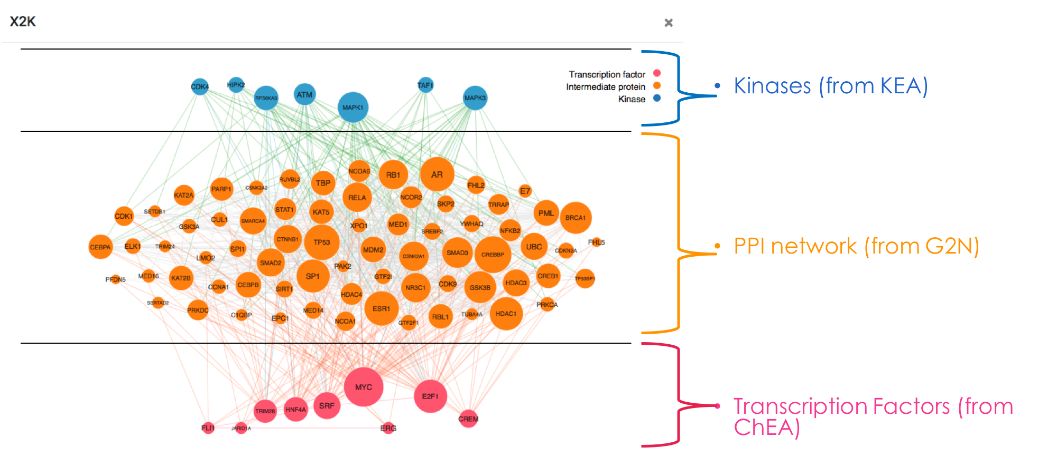
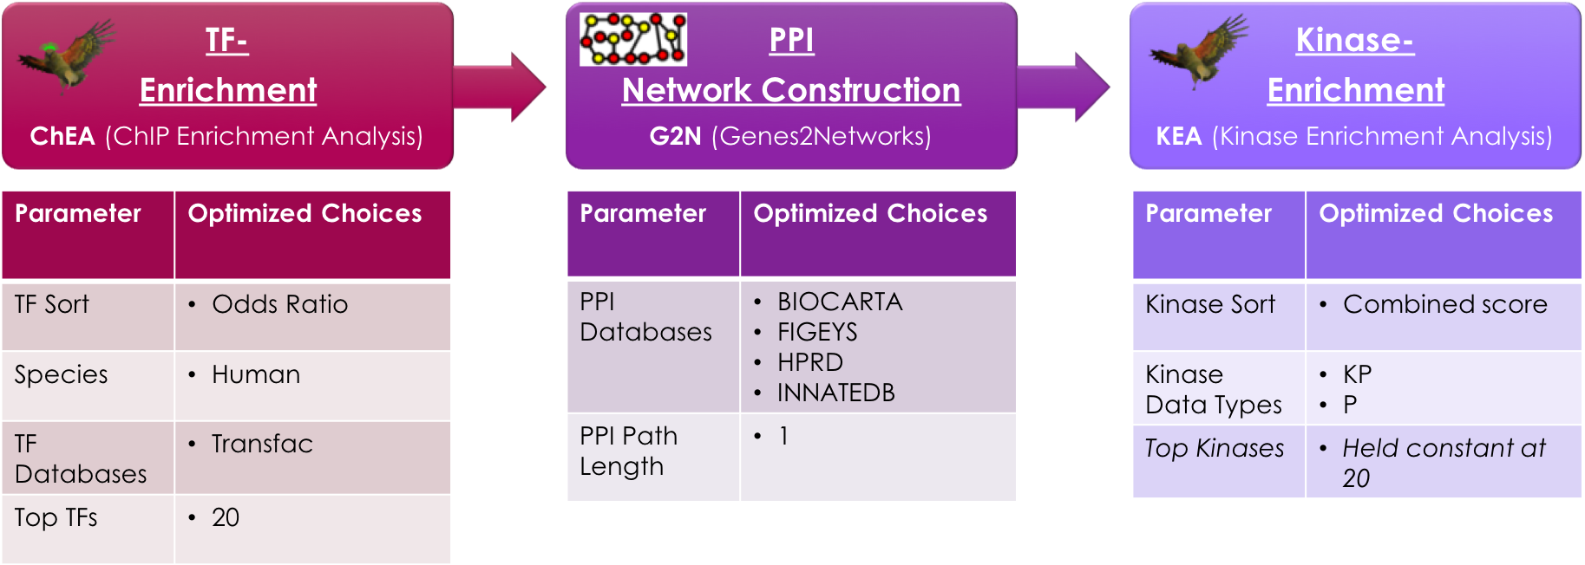
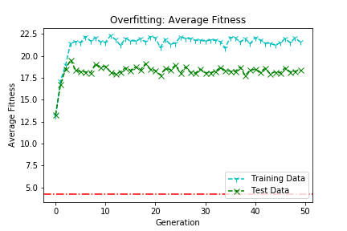
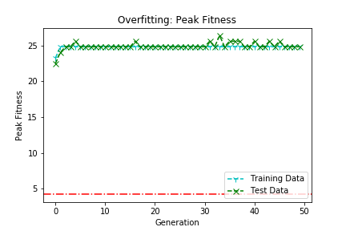
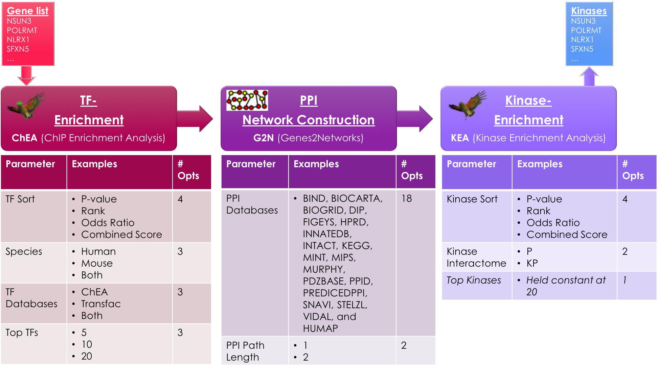
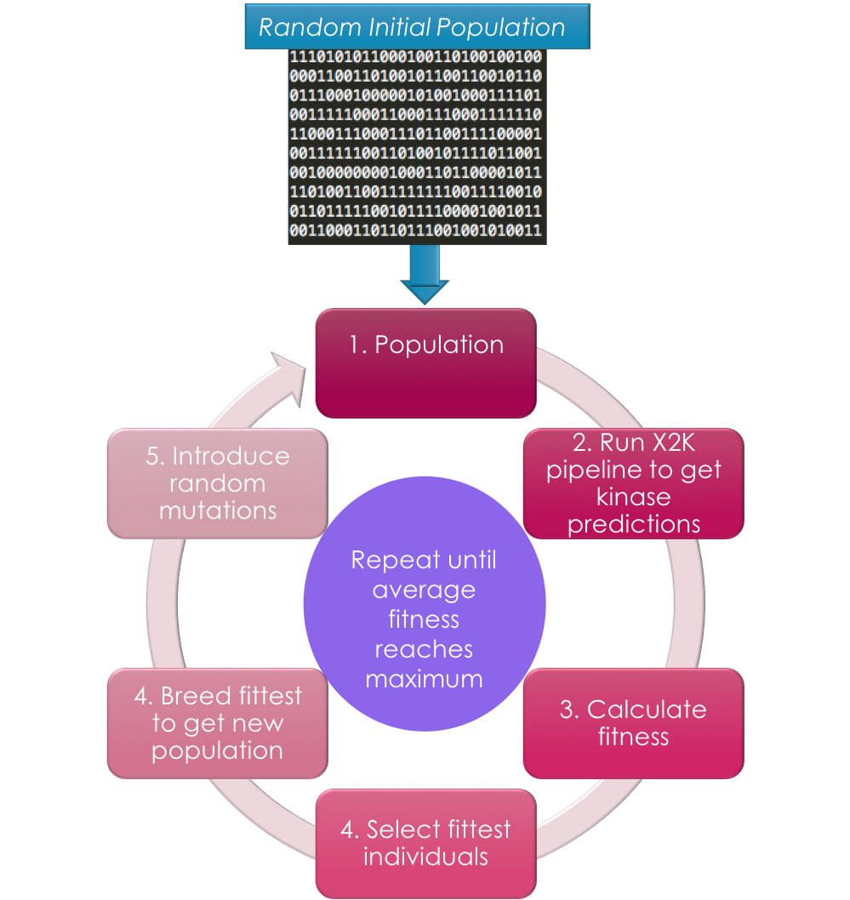
C
Learning X2K: Parameter Optimization Via Genetic Algorithms to Calibrate the Expression2Kinases Pipeline
Brian M. Schilder¹ , Alexander Lachmann¹, Maxim Kuleshov ¹, Avi Ma’ayan¹
¹Big Data to Knowledge (BD2K) Library of Network-based Cellular Signatures (LINCS) Data Coordination and Integration Center (DCIC),
Mount Sinai Center for Bioinformatics, Department of Pharmacological Sciences, Icahn School of Medicine at Mount Sinai, New York, NY
Introduction
Results
Discussion
While whole-transcriptome technologies can accurately measure the level of mRNA at a global scale, and at a relative low cost, directly measuring cell signaling network activity is both less accurate and more expensive. Hence, computational methods to infer cell signaling network activity from gene expression data are needed. Kinases are enzymes that can regulate downstream molecular pathways by phosphorylating other proteins. Due to their regulatory role, kinases are promising targets for a number of diseases. Expression2Kinases (X2K) is a computational pipeline that takes as input lists of differentially expressed genes, it then performs enrichment analysis to prioritize transcription factors that most likely regulate the observed changes in expression. Next, known protein-protein interactions are used to connect the identified transcription factors to form a subnetwork. Finally, kinases enrichment analysis is performed to prioritize protein kinases known to phosphorylate substrates within the subnetwork of transcription factors and intermediate proteins. The workflow can run with a variety of parameter settings and employs a variety of processed background datasets. In this project, we aimed to learn these parameters to optimize the pipeline for identifying the “correct” kinases using genetic algorithms, a machine learning method for parameter optimization.
[Run 1]: X2K GA Results Using GEO Kinase Perturbation Data for Benchmarking
Parameter optimization: While optimal x and y did differ between validation datasets, the following results were consistent:
Rank: More sophisticated results-ordering methods (e.g. combined score) outperformed simpler metrics such as raw p-values and rank.
Databases: The optimization of X2K via GA identified the following databases as relatively optimal for recovering mechanisms of action underlying differential gene expression:
TF-enrichment: 1, 2, 3
PPI construction: 1, 2, 3
Kinase-enrichment: 1, 2, 3
Potential Confounds: X2K is biased towards large PPI networks. However, the average PPI size after the GA stabilized was 477 protein, which is not unreasonably large. Also, the GA chose a PPI path length of 1 (not 2 which would have resulted in a much larger network).
A
Users submit gene lists here
Table 1. Results of a series of one-way ANOVAs statistically testing the relationship between fitness and each parameter.
Main Results:
Stabilized after ~5 generations
Average fitness stabilized at ~22%
Peak fitness = 2% of kinases recovered
Average PPI size = 477 proteins
All parameters except KINASE_Database had a significant impact on fitness.
While there were similar patterns of increasing fitness over generations, the Training and Test data did differ significantly on this run (p<0.001).
Fig1. The X2K Web landing page and an example of its output.
Methods & Materials
B
C
Fig 4. Parameter evolution over generations in GA optimization (A). Overfitting test results between training data and test data using average fitness across the entire population (B) and peak fitness (C).
The X2K Pipeline
The X2K pipeline is comprised of these three components:
[1] ChIP Enrichment Analysis (ChEA): Ranks transcription factors (TF) based on TF targets that are enriched within the input gene list using 2 non-mutually exclusive databases (ChEA, Tranf). There are also 4 mutually-exclusive predicted methods by which TF results were sorted (TF Sort), 3 options by which to subset the TF databases by species (TF species), and 3 options regarding how many of the top most significant predicted TFs to feed into the PPI Network Construction step.
[2] Genes2Networks (G2N): Generates protein-protein interactions (PPI) subnetworks given a list of enriched TFs. G2N draws from the following PPI resources: BioGRID, BioPlex, iREF, hu.MAP, MINT, SNAVI, ppid, and KEGG.
[3] Kinase Enrichment Analysis (KEA): Ranks protein kinases that are known to phosphorylate the proteins within the subnetwork identified by G2N. The KEA step draws kinase-substrate interactions from: PhosphoSite Plus, NetworKIN, iPTMnet and KEA.
Genetic Algorithms for Parameter Tuning the X2K Workflow
X2K has modifiable parameters at each step, for example: gene set library selection, enrichment analysis method, and PPI path length. By implementing genetic algorithms (GA), the X2K pipeline can be optimized to find combinations of parameters that can best recover the "correct" protein kinases responsible for the observed changes in expression.
GA Settings:
Generations: 10
Population Size: 100/generation
Number of fittest individuals per generation bred (and then retained in next population): 10
Crossover points: 3
Random mutation rate: 0.01
To assess the ability of each X2K parameter combination to recover kinases, differentially expressed genes from kinase perturbation experiments were compiled from Gene Expression Omnibus (GEO), or from the LINCS L1000 data. Fitness scores of each parameter combination are defined as the % of experiments in which the known perturbed kinase was recovered, weighted by the perturbed kinase's ranking in the significance-ordered output.
Fig 6. Parameter evolution over generations in GA optimization (A). Overfitting test results between training data and test data using average fitness across the entire population (B) and peak fitness (C).
[Run 2]: X2K GA Results Using LINCS L1000 Drug Perturbation Data
Conclusions
Using optimized parameters, X2K can recover the “correct” kinases at level of ~XX-25% depending on the particular dataset that is . This is considerably greater than chance (~XX-6%).
Potentially greater rates of kinase recovery and consistency across validation datasets can be achieved by adding additional databases.
The pipeline optimization can be divided into two streams: including literature-biased resources, such as PPI and kinase-substrate interactions from extracted from low-content published studies, and high content only pipeline that includes only data from high throughput methods.
The optimized parameters will inform the X2K Web application and used to infer kinases for various projects.
Table 2. Results of a series of one-way ANOVAs statistically testing the relationship between fitness and each parameter.
Main Results:
Stabilized after ~5 generations
Average fitness stabilized at ~22%
Peak fitness = 24.81% of kinases recovered
Average PPI size = 477 proteins
All parameters except Kinase_interactome and TF_background had a significant impact on fitness.
While there were similar patterns of increasing fitness over generations, the Training and Test data did differ significantly on this run (p<0.001).
References & Acknowledgements
Fig 3. Genetic Algorithms identify improved combinations of parameters (coded as binary strings) by searching the fitness landscape.
Stuhlmiller, T. J., Miller, S. M., Zawistowski, J. S., Nakamura, K., Beltran, A. S., Duncan, J. S., … Johnson, G. L. (2015). Inhibition of lapatinib-induced kinome reprogramming in ERBB2-positive breast cancer by targeting BET family bromodomains. Cell Reports, 11(3), 390–404. https://doi.org/10.1016/j.celrep.2015.03.037 Duncan, J. S., Whittle, M. C., Nakamura, K., Abell, A. N., Midland, A. A., Zawistowski, J. S., … Johnson, G. L. (2012). Dynamic reprogramming of the kinome in response to targeted MEK inhibition in triple-negative breast cancer. Cell, 149(2), 307–321. https://doi.org/10.1016/j.cell.2012.02.053 Chen, E. Y., Xu, H., Gordonov, S., Lim, M. P., Perkins, M. H., & Ma’ayan, A. (2012). Expression2Kinases: mRNA profiling linked to multiple upstream regulatory layers. Bioinformatics, 28(1), 105–111. https://doi.org/10.1093/bioinformatics/btr625
This work was partially supported by the NIH Common Fund grant #U54HL127624, BD2K-LINCS DCIC
Fig 5. Parameter evolution over generations in GA optimization (A). Overfitting test results between training data and test data using average fitness across the entire population (B) and peak fitness (C).
Fig 2. Illustration of the X2K pipeline with the modifiable parameters for each respective step, along with several example options, and the total number of options. The gene sets are first entered by the user, which then goes through three stages of the X2K pipeline (TF-enrichment, PPI network construction, and Kinase enrichment) to produce a list of predicted kinases.

